Slide 1
Public Bus Transport Analysis Efficiency
Innovation and Complete Steps About This Project
Submitted By
Name : K.Srinivas
Reg.no : 723921243028
Department : Artificial Intelligence And Data Science

Slide 2
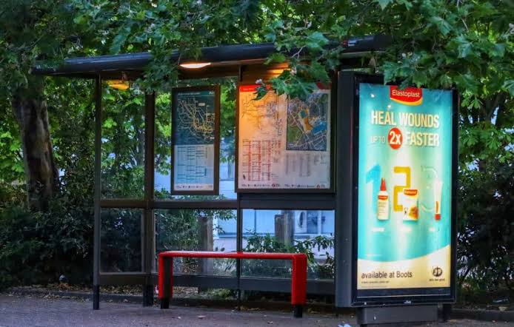
1.Smart Bus Stops:
Smart bus stops are equipped with interactive displays that provide real-time bus arrival information. These displays can also offer weather updates, local news, and safety features such as emergency buttons for passenger security.

Slide 3
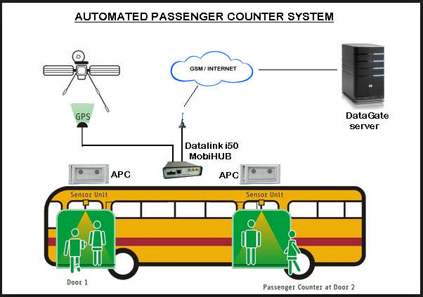
2. Automated Passenger Counting:
Utilize AI-powered cameras or sensors at bus entrances and exits to accurately count passengers boarding and disembarking. This data can be integrated into route optimization algorithms

Slide 4
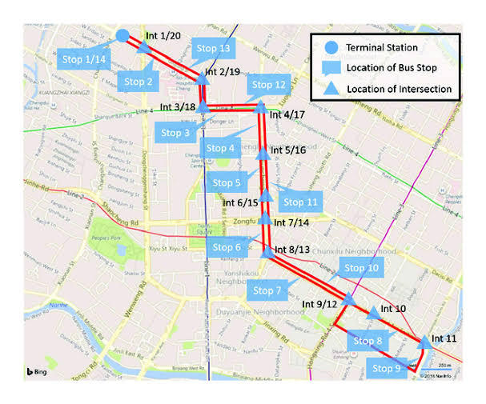
3. Dynamic Bus Routes:
Implement dynamic route planning that adapts in real-time based on factors like passenger demand, traffic conditions, and weather. This can help buses avoid congestion and reduce travel times.

Slide 5
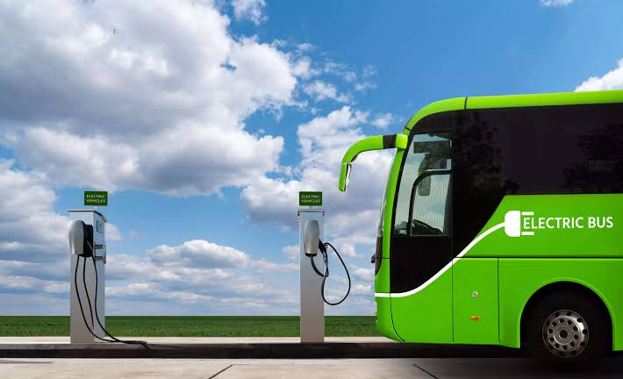
4. Green Bus Fleets:
Transition to green and sustainable bus fleets, including electric, hydrogen, or hybrid buses, to reduce greenhouse gas emissions and lower the environmental impact of public bus transport.

Slide 6
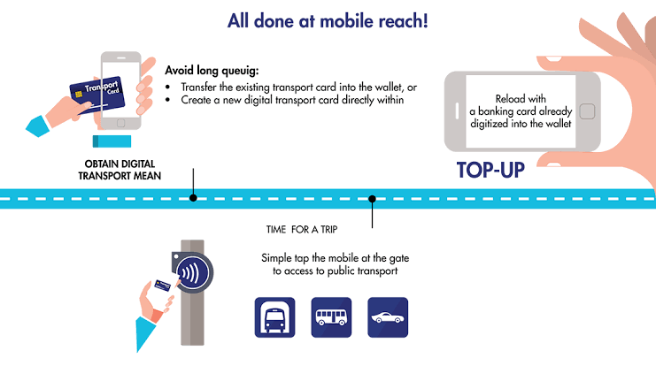
5. Contactless Payments and Mobile Ticketing:
Introduce contactless payment options such as RFID cards or mobile ticketing apps, enabling passengers to pay without cash. This streamlines boarding and reduces well times.

Slide 7
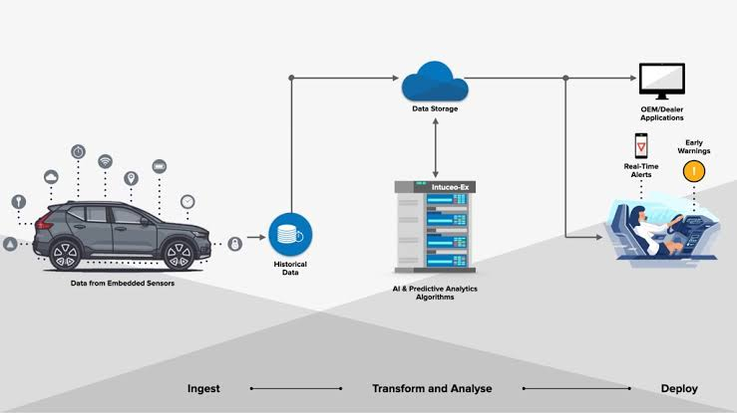
6. AI-Based Maintenance Predictions:
Utilize predictive maintenance algorithms that analyze vehicle sensor data to forecast maintenance needs. This minimizes unexpected breakdowns, improves fleet reliability, and reduces downtime

Slide 8
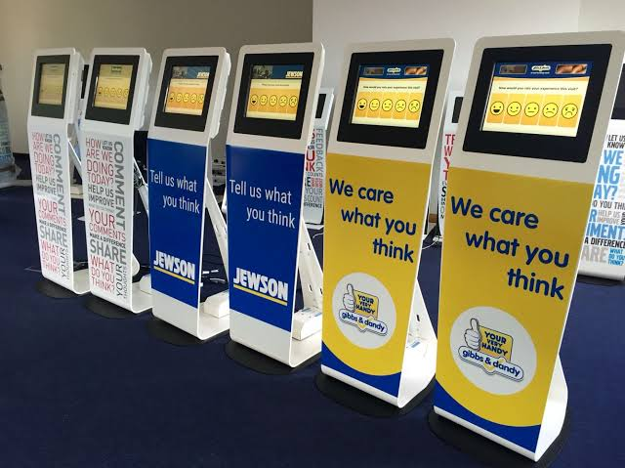
7. Passenger Feedback Kiosks:
Install kiosks inside buses where passengers can provide real-time feedback on their travel experience. This data can be analyzed to identify areas for improvement.

Slide 9
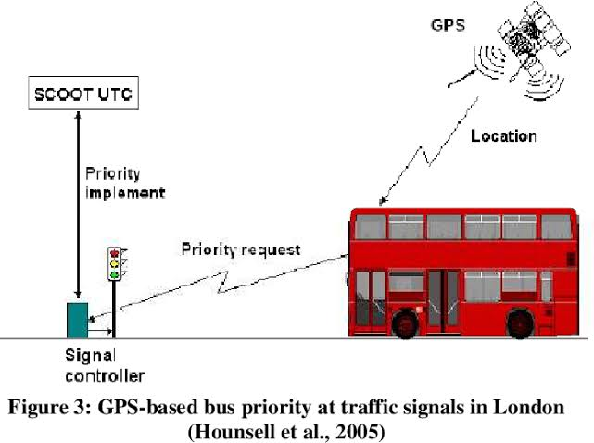
8. Traffic Signal Priority:
Equip buses with technology that communicates with traffic signals, granting priority to buses at intersections. This reduces delays and ensures more consistent schedules.

Slide 10
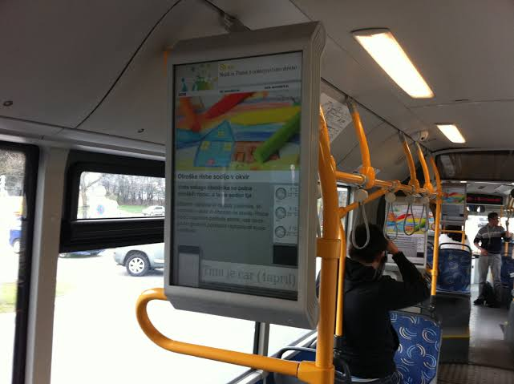
9. Digital Signage Inside Buses:
Outfit buses with digital screens that display real-time information, advertisements, and passenger announcements. This enhances the travel experience and can serve as an additional revenue source through advertising.

Slide 11
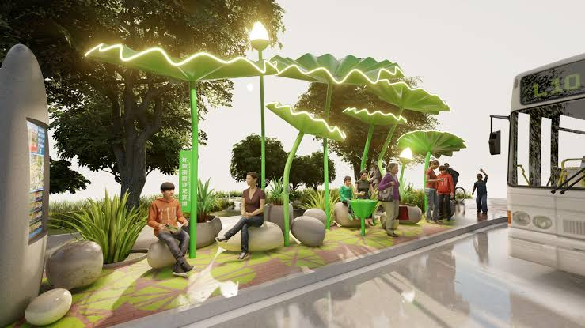
10. Eco-Friendly Bus Stops:
Design eco-friendly bus stops with features like solar panels for power, green roofs to absorb rainwater, and rainwater harvesting systems. These innovations can reduce energy consumption and minimize environmental impact.

